Slide 1


Green Pace
Security Policy Presentation
Developer: Elliot Putnam
CS405 Secure Coding
Southern New Hampshire University
8/18/24

Slide 2

OVERVIEW: DEFENSE IN DEPTH
This illustration of “Defense in Depth” depicts the layers of security required to protect the core (critical assets / system data). Each layer has been carefully chosen to form a strong defensive layering system.

Slide 3
THREATS MATRIX
1 – Date Type (One Definition Rule)
2 – Data Value (overflow)
3 – String Correctness (Avoid null ptr)
4 – SQL Injection (sanitize strings)
5 – Memory Protection
6 – Assertions (static asserts)
7 – Exceptions (always catch except)
8 – Sequence of Events
9 – Integer Precision
10 – Buffer Overflow

Slide 4
10 PRINCIPLES
1 – Validate Input Data
002 – Data Value
2 – Heed Compiler Warnings
005 – Memory Protection
003 – String Correctness
3 – Architect and Design for Security Policies
006 – Assertions
004 – SQL Injection
001 – Data Value
4 – Keep It Simple
010 – Buffer Overflow
008 – Sequence of Events
001 – Data Value
5 – Default Deny
005 – Memory Protection
6 – Adhere to the Principle of Least Privilege
005 – Memory Protection
7 – Sanitize Data Sent to Other Systems
004 – SQL Injection
8 – Practice Defense in Depth
*** – All
9 – Use Effective Quality Assurance Techniques
007 – Exceptions
006 – Assertions
005 – Memory Protection
10 – Adopt a Secure Coding Standard
010 – Buffer Overflow
008 – Sequence of Events
007 – Exceptions
001 – Data Value

Slide 5
CODING STANDARDS

Slide 6
ENCRYPTION POLICIES
In Rest
Encryption in rest protects data that is stored within storage devices.
In Flight
Encryption in flight protects data that is being sent or received over a medium
In Use
Encryptions in use protects data that is being creating, used, or manipulated

Slide 7
TRIPLE-A POLICIES
Authentication
Confirming a user identity
Authorization
Assigning permissions to a user after authentication
Accounting
Tracking user and system data to log a traceback in case of event

Slide 8
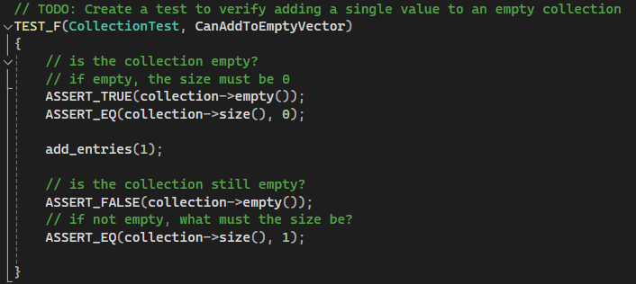
Unit Testing
Test to verify adding to an empty vector

Slide 9
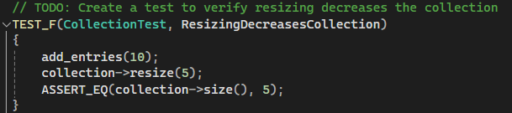
Unit Testing
Test to verify resizing properly decreased collection

Slide 10
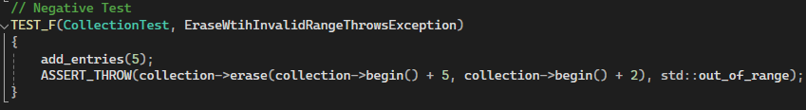
Unit Testing
Negative test – ErasewithInvalidRangeThrowsException

Slide 11
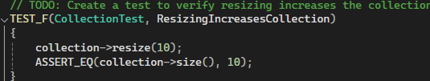
Unit Testing
Test to verify resizing increases collection

Slide 12

AUTOMATION SUMMARY

Slide 13
TOOLS
CPPCheck: static code analysis (https://cppcheck.sourceforge.io/)
Static Analysis tool which checks source code for errors, bugs, and quality issues without running the code. For use in early development to strengthen the backbone of the source code prior to launching and testing further.
Clang: front-end compiler (https://clang.llvm.org/)
A front-end compiler that translates source code into an ‘intermediate representation’ and can optimize and transformed into code for the back-end.
Parasoft: automated testing suite (https://www.parasoft.com/)
Automated testing like unit testing, integration testing and coverage analysis. Can be used after compiling to ensure compiled code behaves correctly.

Slide 14
RISKS AND BENEFITS
Risks of waiting to act may involve data loss which is a root cause for customer loss, financial loss, and potentially system loss depending on the severity of attack.
Acting fast to mitigate damage, prevent future threats, and reoperate any sensitive systems which will alleviate some of the incidents in the risks description.

Slide 15
RECOMMENDATIONS
Update security policy regularly to stay ahead of threats
Offer comprehensive employee training to mitigate data loss via inside actor
Create and update an incident response plan and be ready to act if an incident occurs
Identify critical assets and enroll a security standards check to cover each one
Perform policy checks and user cleanup regularly to reduce the risk of access from unused accounts

Slide 16
CONCLUSIONS
ISO/IEC 27001 – Information Security Management
This standard provides a framework for establishing, implementing, and maintaining an information security management system (ISMS). This helps the organization manage their information security risks with efficiency and effectiveness.
NIST Security Framework
The National Institute of Standards and Technology (NIST) Cybersecurity Framework offers guidelines for managing and reducing cybersecurity risks. It includes core functions like Identify, Protect, Detect, Respond, and Recover.
General Data Protection Regulation
GDPR sets strict guidelines for data protection and privacy in the European Union. It mandates how organizations should handle personal data and respond to data breaches.

Slide 17
REFERENCES
International Organization for Standardization. (2013). ISO/IEC 27001:2013 Information technology — Security techniques — Information security management systems — Requirements. Retrieved from https://www.iso.org/standard/54534.html
National Institute of Standards and Technology. (2018). Framework for Improving Critical Infrastructure Cybersecurity, Version 1.1. Retrieved from https://nvlpubs.nist.gov/nistpubs/CSWP/NIST.CSWP.04162018.pdf
European Union. (2016). Regulation (EU) 2016/679 of the European Parliament and of the Council of 27 April 2016 on the protection of natural persons with regard to the processing of personal data and on the free movement of such data (General Data Protection Regulation). Retrieved from https://eur-lex.europa.eu/eli/reg/2016/679/oj

